Slide 1
CS 4504 Parallel and Distributed Computation Distributed Consensus
Kun Suo
Computer Science, Kennesaw State University
https://kevinsuo.github.io/

Slide 2
Revisit Distributed Election
Distributed election is to select a master node from multiple nodes
Every node has the right to elect and to be elected
Most election methods use a majority strategy: a node can only become the master node if it has the approval of most nodes

Slide 3
Revisit Distributed Election
Distributed election is an example of distributed consensus
Every node follows the same rule (the majority strategy) to elect and be elected
Every node gets involved and the results can be trusted

Slide 4
Another Example of Distributed Consensus: distributed accounting
Centralized accounting:
E.g., suppose only one bank exists in U.S.
Potential problems:
The master node is very easy for accounting fraud
The master node could be performance bottlenecks
Low reliability, e.g., master node fails

Slide 5
Another Example of Distributed Consensus: distributed accounting
Distributed accounting:
No centralized node
Any server that sees one transaction can record this transaction
Potential benefits:
Results are trusted and accurate
System is strong and has high reliability

Slide 6
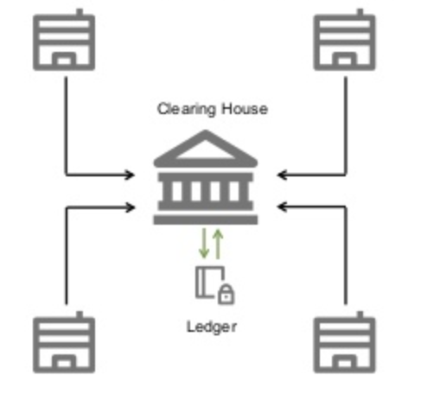
What is Distributed Consensus?
Example:
5 servers located at Georgia, Florida, Texas, California and New York
User A in GA send $100 to user B in TX
Traditional solution:
A – 100 and B + 100
Keep the record at centralized server

Slide 7
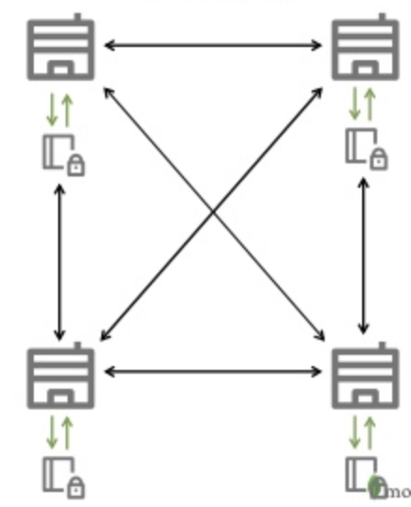
What is Distributed Consensus?
Example:
5 servers located at Georgia, Florida, Texas, California and New York
User A in GA send $100 to user B in TX
Distributed solution:
How to keep the data consistent in each server
Distributed consensus is the process of making all nodes agree on a certain state when multiple nodes can operate or record independently.

Slide 8
Difference between Consistency and Consensus
Consistency: the data or status presented to the outside is consistent after a series of operations among multiple nodes in a distributed system
Consistency refers to the results
Consensus: the process that multiple nodes in a distributed system reach an agreement.
Consensus refers to the process

Slide 9
How to Achieve Distributed Consensus?
Distributed consensus is the process of making all nodes agree on a certain state when multiple nodes can operate or record independently.
Solution:
PoW (Proof-of-Work)
PoS (Proof-of-Stake)
DPoS (Delegated Proof of Stake)

Slide 10
1. PoW (Proof-of-Work)
In distributed election, only one node in the same round of elections could be the master node
In distributed accounting, for one transaction, only one node can obtain the accounting right, and then reaches an agreement with other nodes for the accounting results
Two key points in distributed accounting :
Accounting right
Agreement

Slide 11
1. PoW (Proof-of-Work)
PoW algorithm is a mechanism that competes for accounting rights based on the computing power of each node.
Whoever has stronger computing power will be more likely to obtain accounting rights.
VS
VS

Slide 12
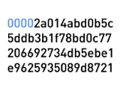
1. PoW (Proof-of-Work)
How to measure the computing power?
Every node has to solve a problem
Whoever solves it first has the most computing power
What is the problem?
Hashing value
the index of the block
the hash value of the previous block
the timestamp of the transaction
the block data
the nonce value
SHA256
hashing
Determine if the first k values are all 0
https://en.wikipedia.org/wiki/Cryptographic_nonce
If not, increase nonce and do it again

Slide 13
1. PoW (Proof-of-Work)
Hashing value
the index of the block
the hash value of the previous block
the timestamp of the transaction
the block data
the nonce value
SHA256
hashing
Determine if the first k values are all 0
https://en.wikipedia.org/wiki/Cryptographic_nonce
If not, increase nonce and do it again
Whoever solves it first can get the accounting rights
After the node gets the right, it updates the transaction and make an agreement with other nodes to make it effective

Slide 14
1. PoW (Proof-of-Work)
Example:
5 servers located at Georgia, Florida, Texas, California and New York
User A in GA send $100 to user B in TX
GA
NY
FL
CA
TX

Slide 15
1. PoW (Proof-of-Work)
Step 1: Generate new transactions, broadcast to the entire network, and require accounting for transactions
GA
NY
FL
CA
TX

Slide 16
1. PoW (Proof-of-Work)
Step 2: After each node receives this request, it puts the received transaction information into a block. Each node uses the PoW algorithm to calculate the hash value of the block and gets a proof of computing power.
GA
NY
PoW
FL
PoW
CA
TX
PoW
PoW

Slide 17
1. PoW (Proof-of-Work)
Step 3: If node TX gets a proof of work, it broadcasts to the whole network. If the transaction contained in the block is valid and have not existed before, other nodes will recognize the validity of the block.
GA
NY
PoW
FL
PoW
CA
TX
PoW
PoW

Slide 18
1. PoW (Proof-of-Work)
Step 4: When other nodes receive the broadcast and confirm its validity, they will accept the new block and put it at the end of blockchain.
confirmation
GA
NY
PoW
FL
PoW
confirmation
confirmation
CA
TX
PoW
PoW
confirmation

Slide 19
1. PoW (Proof-of-Work)
Advantages:
Simple
Good fairness
High reliability, e.g., to break this system, you have to own 51% of the entire computing power of the entire system

Slide 20
1. PoW (Proof-of-Work)
Disadvantages:
Requires the entire network to participate the calculation, which increases the calculation amount of each node
If the problem is too difficult, it will lead to long calculation time and high resource consumption
If the topic is too simple, it will cause many nodes to obtain the accounting right at the same time and introduce too many conflicts.
Long cycle to achieve consensus, low efficiency, and high resource consumption

Slide 21
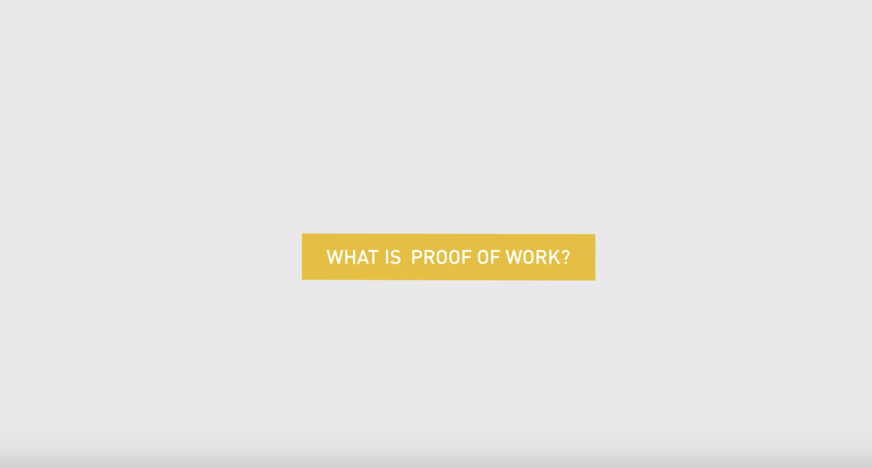
1. PoW (Proof-of-Work)
https://youtu.be/3EUAcxhuoU4

Slide 22
2. PoS (Proof-of-Stake)
Key idea: using equity (wealth or age) instead of computing power to determine the accounting right
Whoever has more equities will be more likely to obtain accounting rights.

Slide 23
2. PoS (Proof-of-Stake)
Equity (wealth or age) example:
If you hold 100 coins for a total of 50 days, then your coin age is 5000
If you find a PoS block, your coin age will be reduced by 365. For every 365 coin age reduction, you can get 0.05 coin interest from the block (as 5% annual interest rate)
Equity = coins * ages * 5% / 365

Slide 24
2. PoS (Proof-of-Stake)
Example:
A network containing 3 nodes: A, B, C
A: 10000 coins, 30 days; B: 1000 coins, 15 days; C: 2000 coins, 20 days.
10000, 30
A
1000, 15
B
C
2000, 20

Slide 25
2. PoS (Proof-of-Stake)
Step 1: Generate new transactions, broadcast to the entire network, and require accounting for transactions
10000, 30
A
1000, 15
B
C
2000, 20

Slide 26
2. PoS (Proof-of-Stake)
Step 2: After each node receives this request, it puts the received transaction information into a block. Each node uses the PoS algorithm to calculate the hash value of the block and gets a proof of equity.
PoS
10000 * 30 * 5% / 365
A
PoS
1000 * 15 * 5% / 365
B
C
2000 * 20 * 5% / 365
PoS

Slide 27
2. PoS (Proof-of-Stake)
Step 3: A gets a proof of equity; it broadcasts to the whole network. If the transaction contained in the block is valid and have not existed before, other nodes will recognize the validity of the block.
PoS
10000 * 30 * 5% / 365
A
PoS
1000 * 15 * 5% / 365
B
C
2000 * 20 * 5% / 365
PoS

Slide 28
2. PoS (Proof-of-Stake)
Step 4: When other nodes receive the broadcast and confirm its validity, they will accept the new block and put it at the end of blockchain.
PoS
10000 * 30 * 5% / 365
A
PoS
1000 * 15 * 5% / 365
B
C
2000 * 20 * 5% / 365
PoS
confirmation
confirmation

Slide 29
2. PoS (Proof-of-Stake)
Advantages:
Does not need to consume a lot of computing and power to ensure the security of the blockchain network
Reduced time required to reach consensus

Slide 30
2. PoS (Proof-of-Stake)
Disadvantages:
The more or the longer the coin is held, the easier it will be for the node to get the accounting right, while the nodes holding less coins will have little chance.
Unfairness and monopoly happens
Unbalanced network

Slide 31
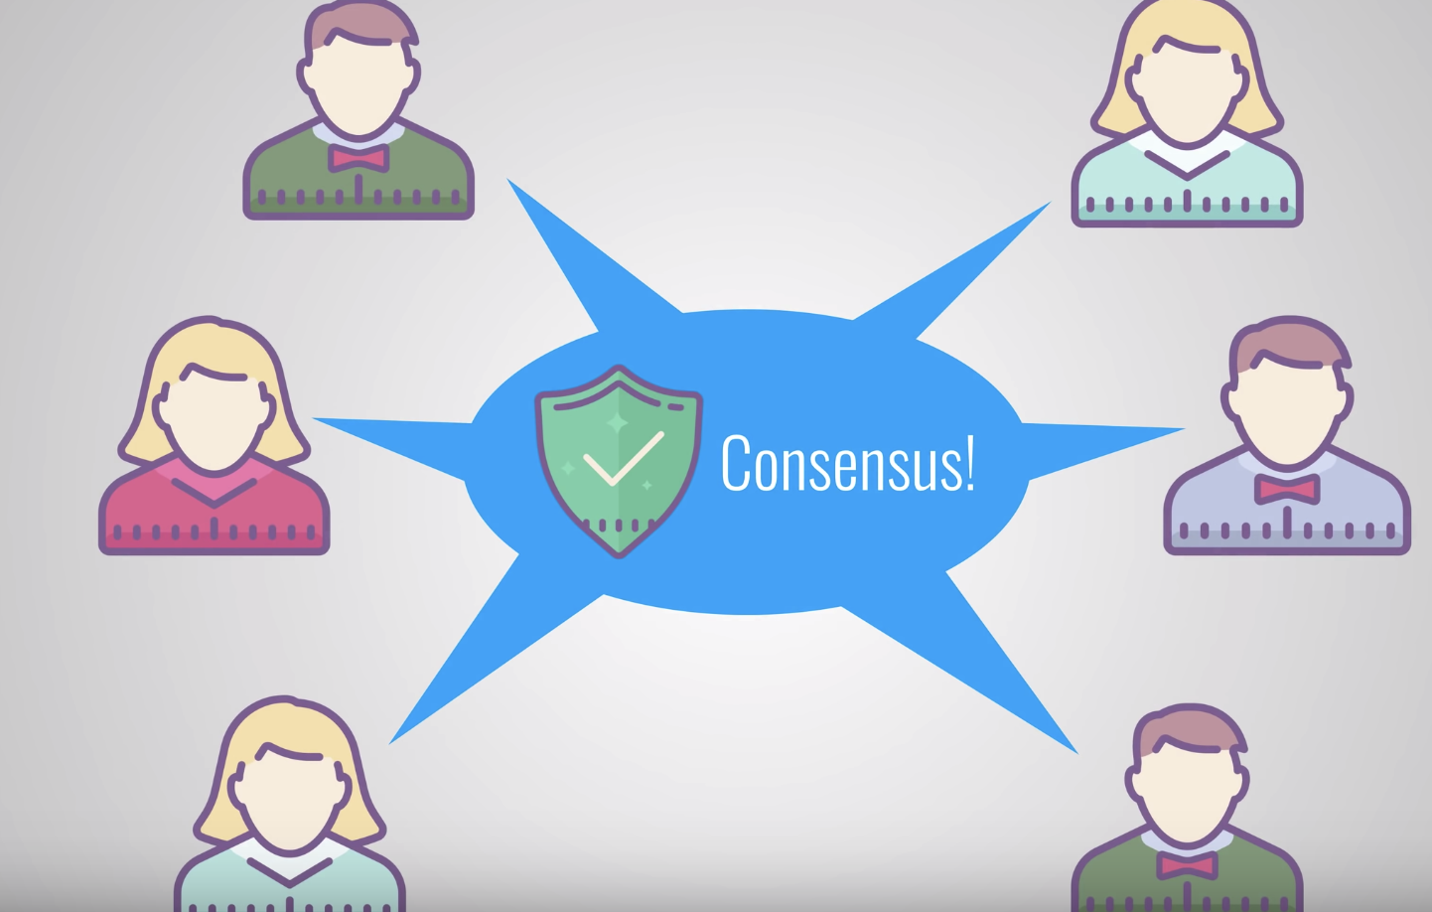
2. PoS (Proof-of-Stake)
https://youtu.be/M3EFi_POhps

Slide 32
3. DPoS (Delegated Proof of Stake)
DPoS is similar as U.S. House
Votes selects representatives to make a decision

Slide 33
3. DPoS (Delegated Proof of Stake)
User votes for delegates to compete for the accounting right
Every user has different voting power. For instance, suppose the total stock share is 1000, the user holding 10 shares has 1/100 voting power
(10)
(20)
vote
delegate
(10)
(30)
vote
vote
delegate
delegate
(50)
(60)

Slide 34
3. DPoS (Delegated Proof of Stake)
After the delegates are elected, they compete for the accounting right based on their computing power
(10)
(20)
vote
delegate
compete
compete
(10)
(30)
vote
vote
delegate
delegate
(50)
(60)
compete

Slide 35
3. DPoS (Delegated Proof of Stake)
Advantages:
Several more trustworthy delegates elected by voters competes the accounting right, which reduces all nodes participating in competition, making less communications, shorter consensus time, less energy consumption and faster agreement speed
Over a period, new delegates will be elected to avoid fraud and monopoly

Slide 36
3. DPoS (Delegated Proof of Stake)
Disadvantages:
Less fairness: DPoS users with small stakes can decide that their vote doesn't matter in comparison with votes of bigger stakeholders
Low reliability for delegate nodes: once the node fails, it leads to potential security risks

Slide 37
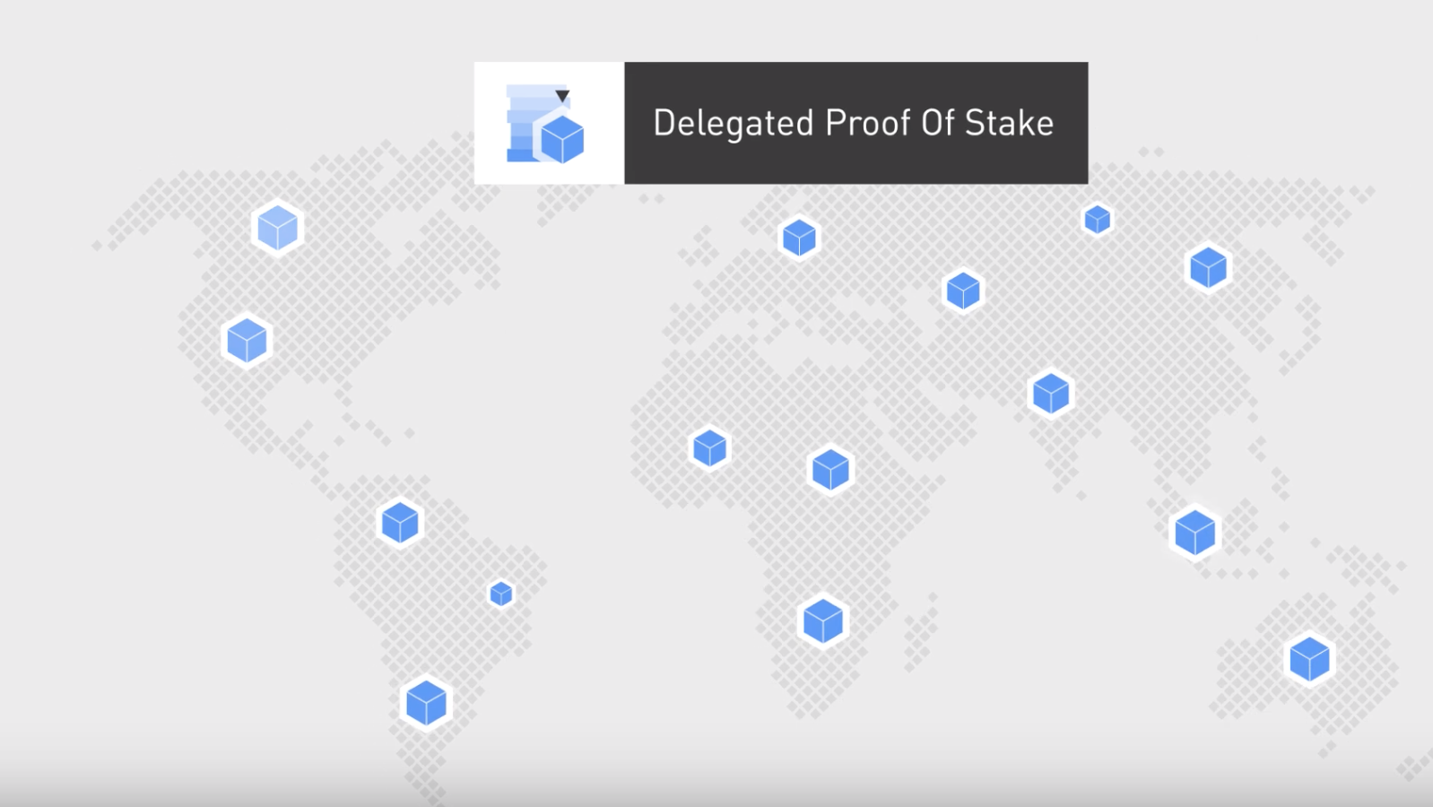
3. DPoS (Delegated Proof of Stake)
https://youtu.be/OVKAOwzAwHI

Slide 38
Comparison
 | PoW | PoS | DPoS
Computing consumption | High | Medium | Low
Structure | Distributed | Distributed | Distributed but having some centers
Performance (throughput) | PoW < PoS < DPoS
Transaction cost | High | Low | Low
Application platform | Bitcoin | Ethereum | Bitshares

